Slide 1

Morgan State Team 2
A web scraper designed to determine how much chatter there was about Covid-19 in the CNN Business articles
during the Beginning Stages of Covid
(March 2020 to April 2020)

Slide 2

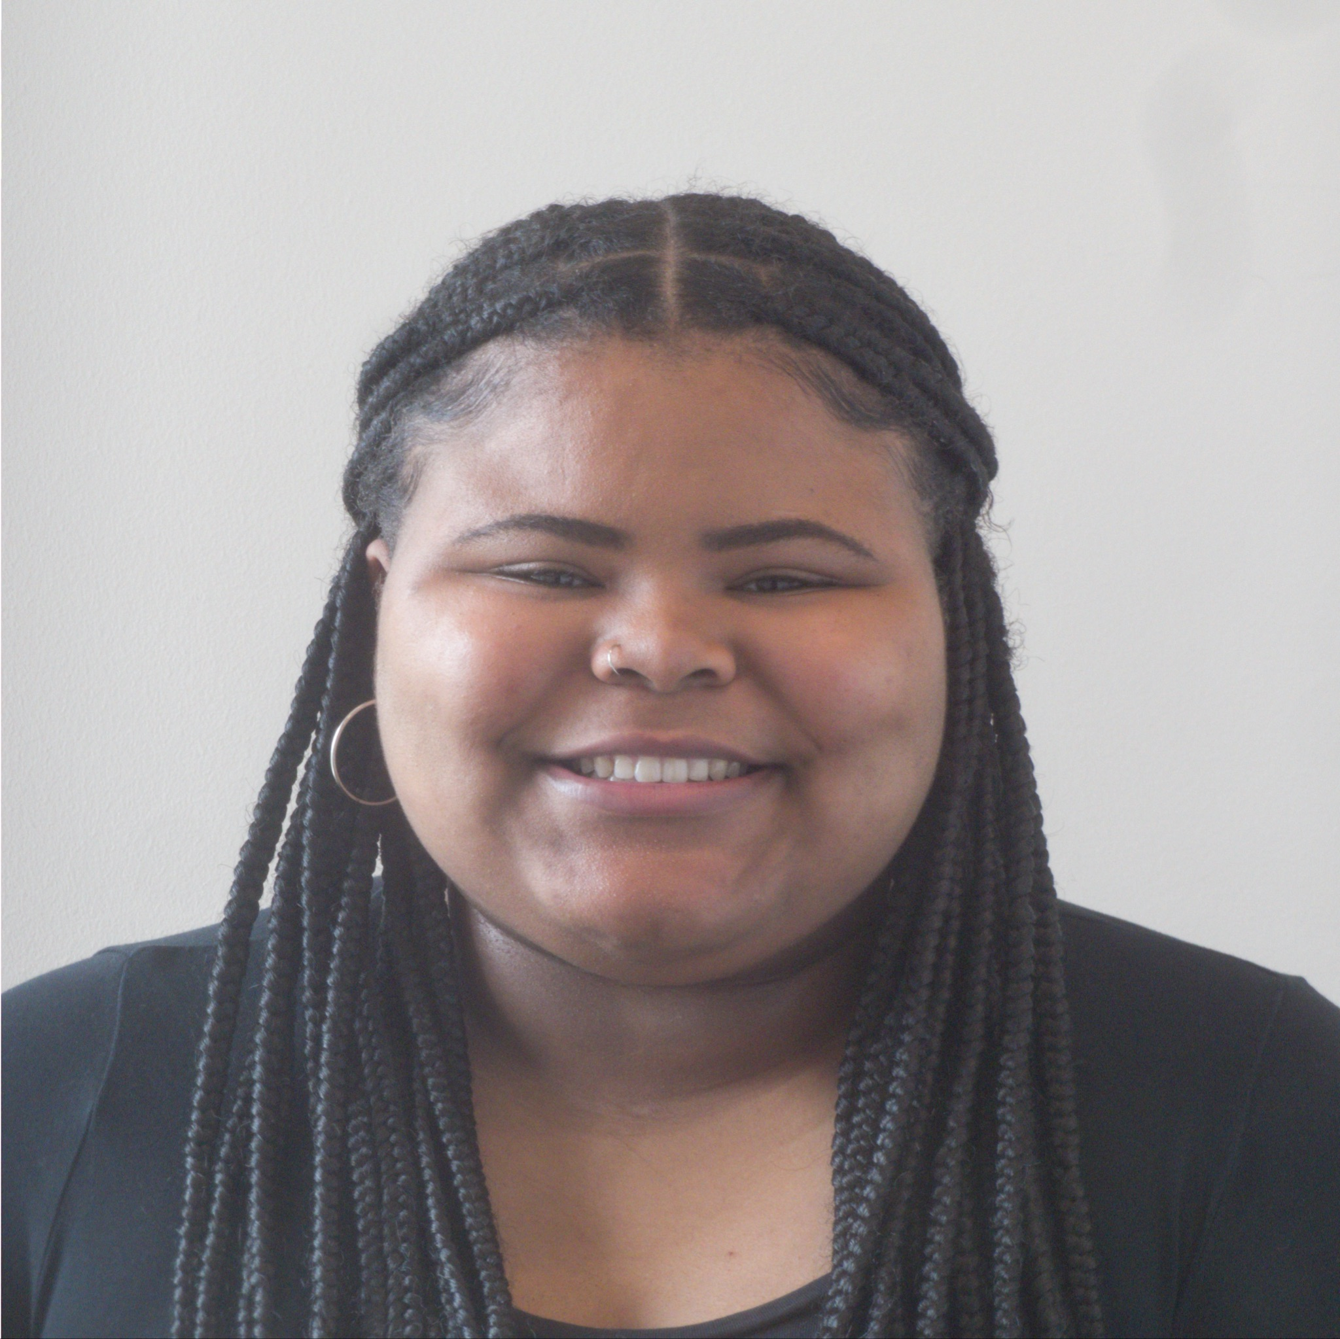
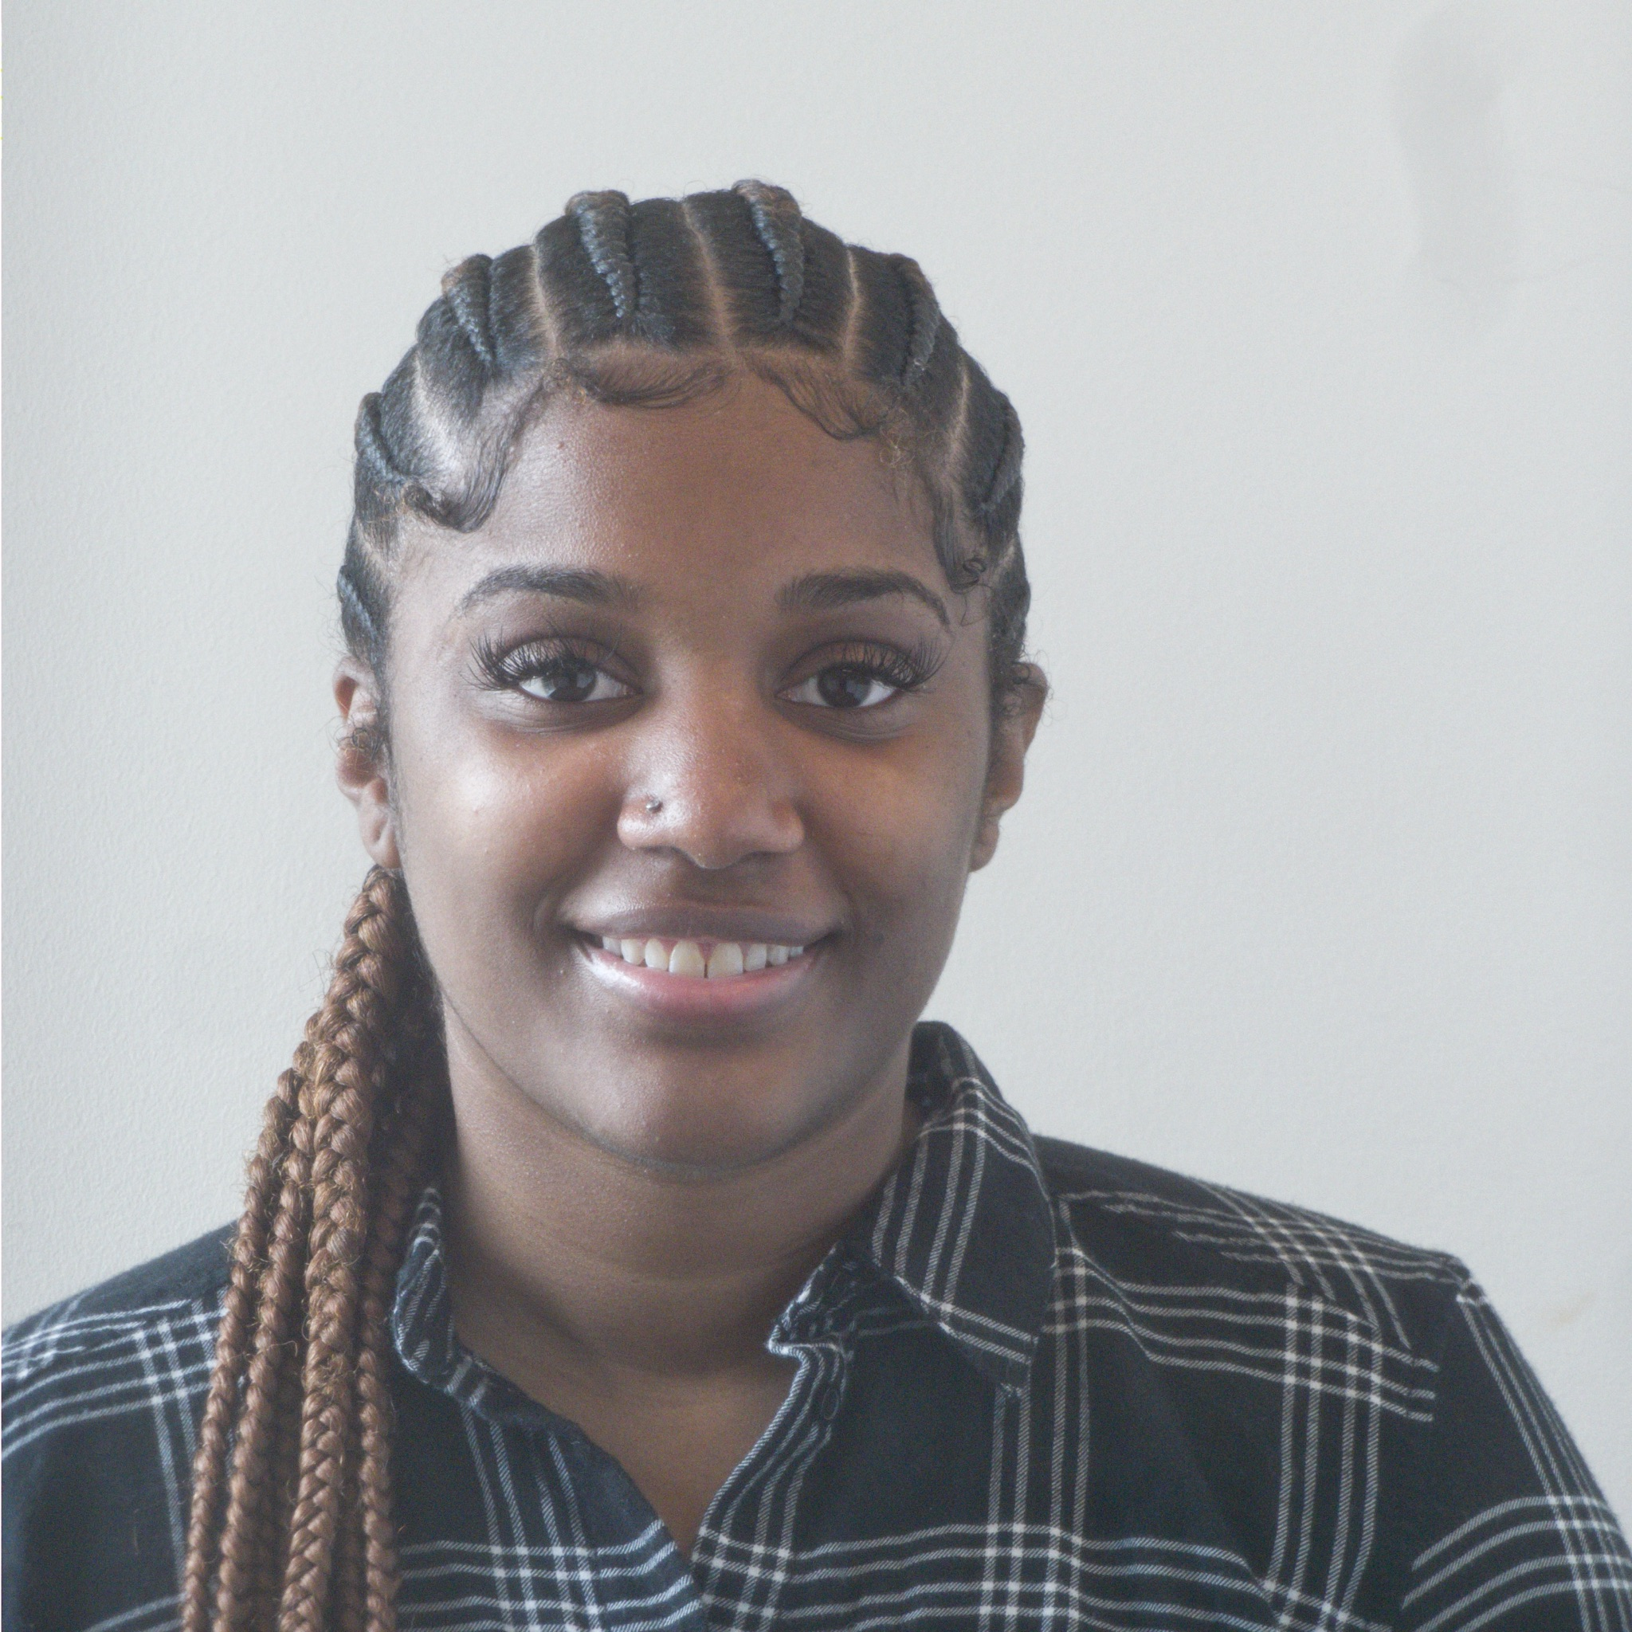
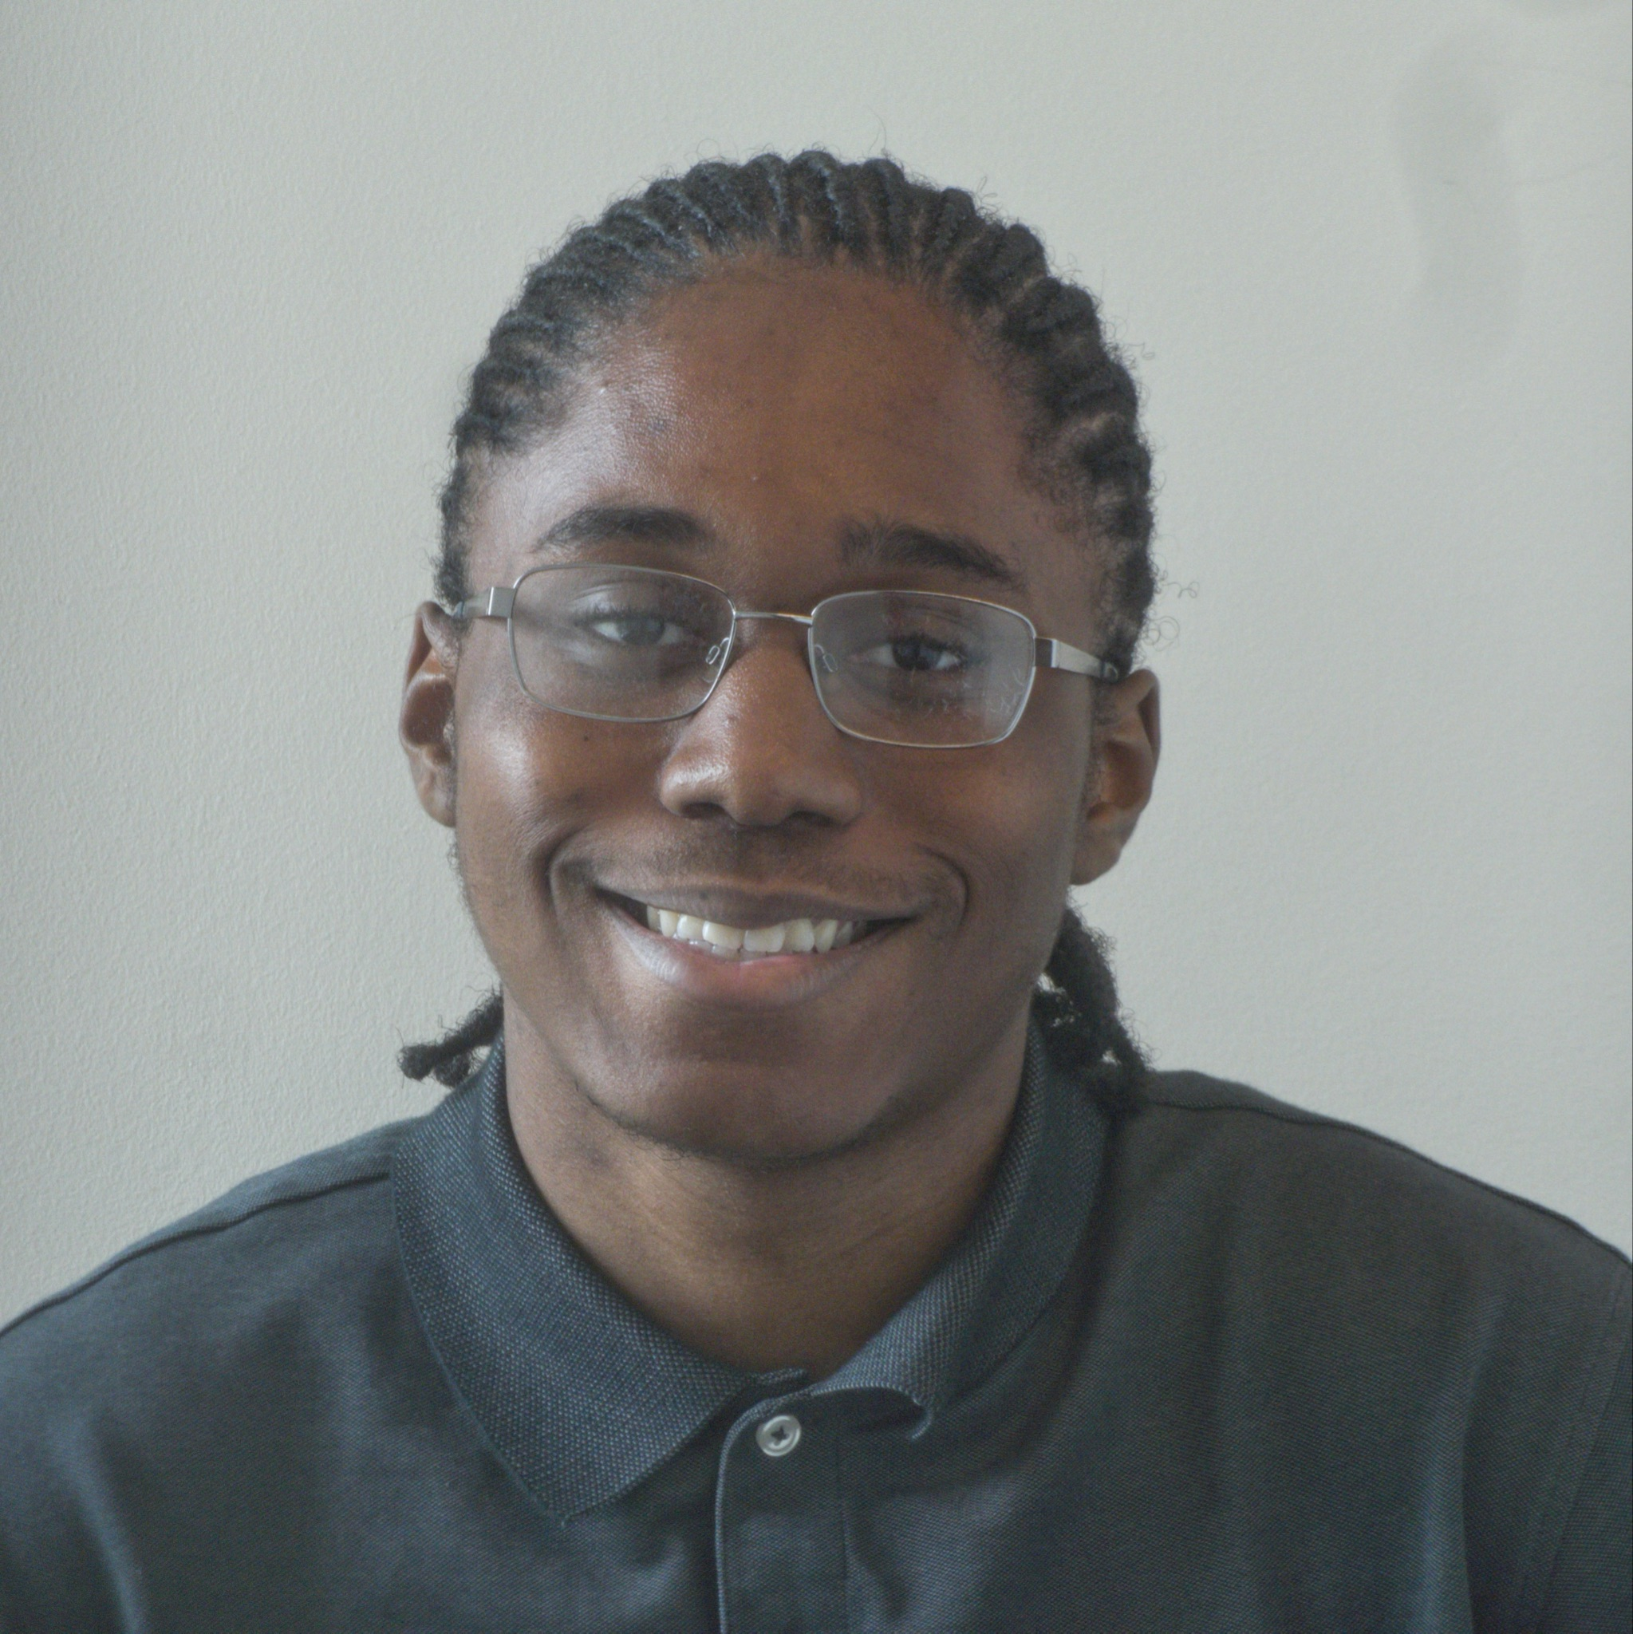

Meet the Team
Chelsea Amihere
Junior
Computer Science
Jadyn Godsey
Sophomore
Civil Engineering
Kourtney Garrett
Junior
Electrical Engineering
Dominick Davis
Junior
Electrical Engineering
Kyle Garcia
Senior
Industrial Engineering

Slide 3

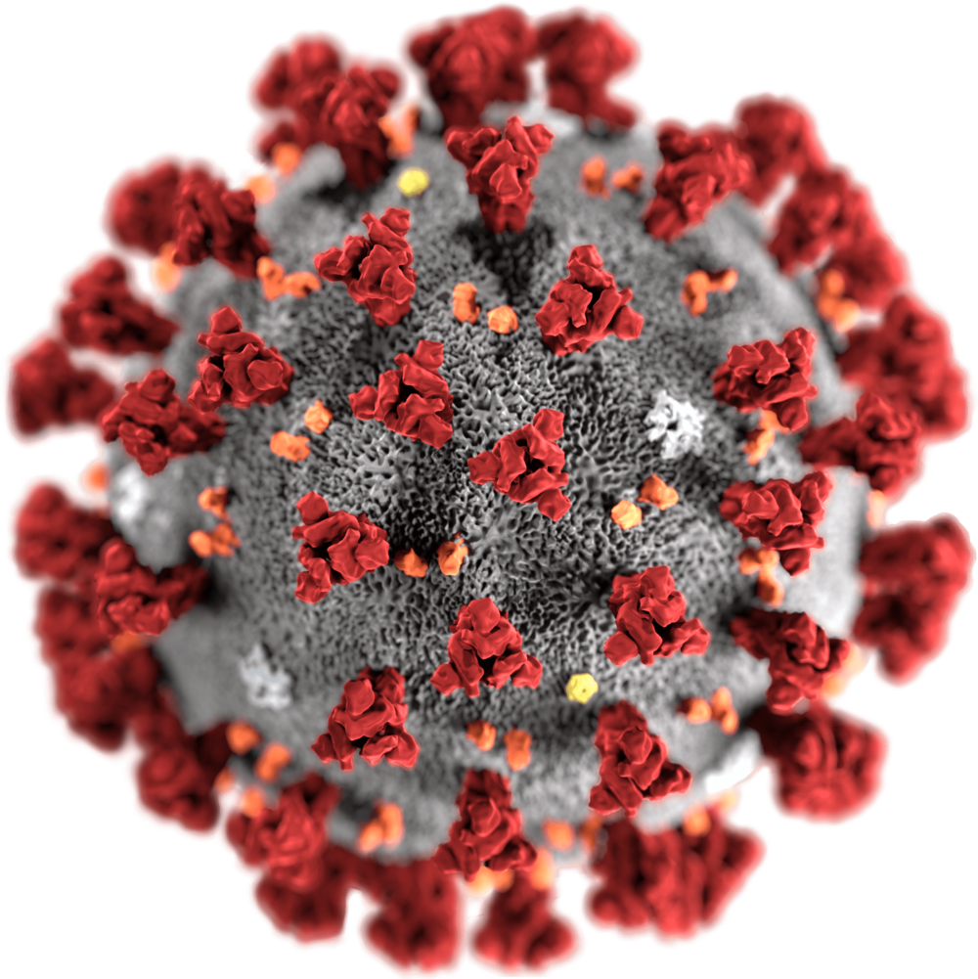
Overview
What is our project?
In this capstone project, we are applying Machine Learning concepts and data skills to scan and analyze articles that relate to covid from the business pages of CNN from the start of the pandemic in March of 2020 until April of 2020.
Our Goal:
Our goal for this project is to use what we have learned about Machine Learning in order to be able to deliver on the requirements for this project

Slide 4

Natural Language Processing
What is used for?
It interlinks computer and human language, which allowed us to take a large set of data and analyze it to create our web scraper

Slide 5
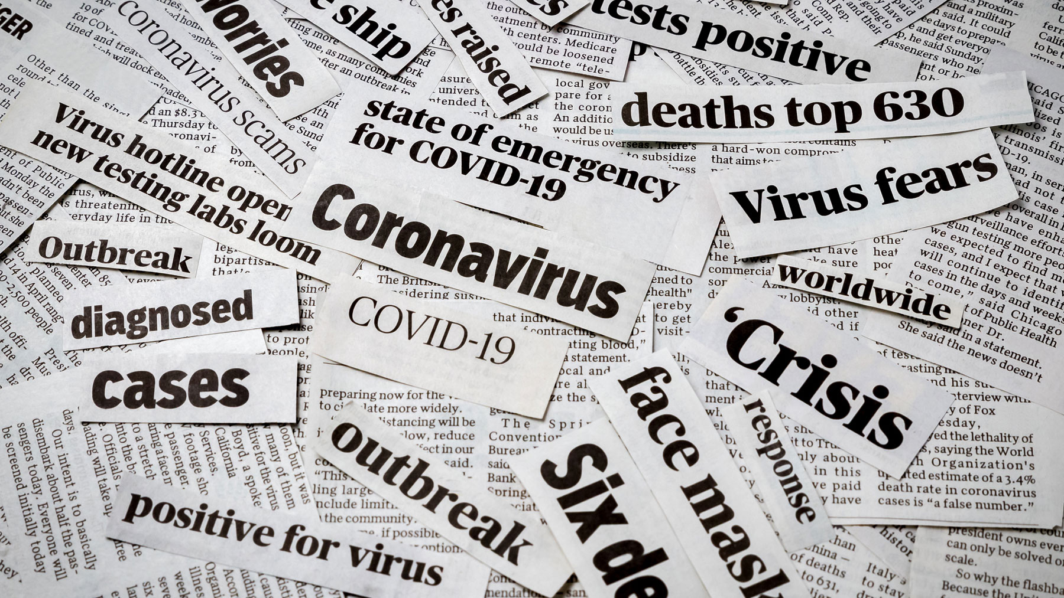

Why Did We Choose This Topic?
The prompt sparked our interest due to how much of an impact Covid had across the nation.

Slide 6
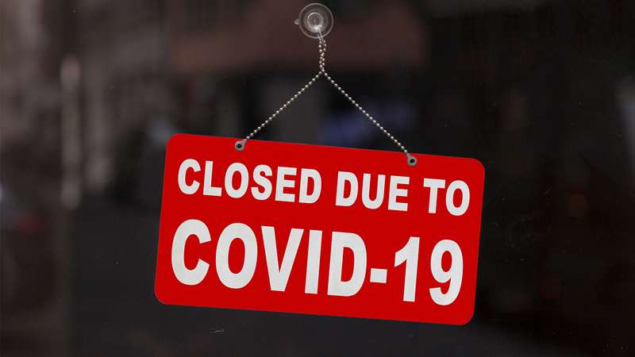

How Does This Topic Affect Our Community
Covid had a negative effect on our nation as a whole
Chatterbot focuses on the emotionally volatile conversations that were being talked and written about in the media.
Sheds light on some things that became important to people because of the pandemic like shutting down businesses and social distancing.

Slide 7
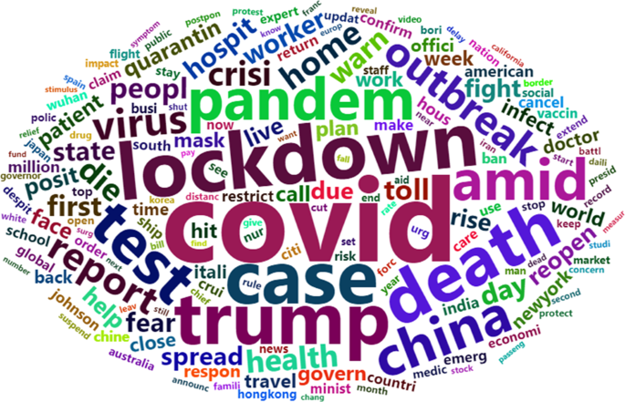
Consensus
After analyzing the articles published by CNN, and researching words that were most prevalent during the months of March 2020 and April 2020, we have concluded that there was a lot of chatter related to the pandemic in the Business articles of CNN.

Slide 8
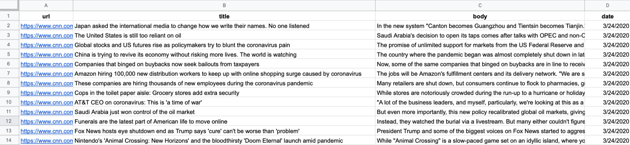
Given a dataset with 300 CNN Business articles, we searched these articles and determined what were the most commonly used words. Therefore, we searched the column “body” for the most frequently used words amongst the body of all the articles.
How Did We Come to this Consensus?

Slide 9
Data Process
Read cnn_data
Read Pandemic.txt
Count the frequency of every word in cnn_data
The word is a stopword
False
Add the word and its frequency to a new dataset
This word from Pandemic.txt exist in the new dataset
True
False
True
No Action
No Action
Add word to a new dataset and add + 1 for every article it appears on

Slide 10

Roadblocks Along the Way
Initial output was returning articles and prepositions such as
and, to, the, but , then, there, etc.
In order to be able to focus on the important words, we had to filter out these overly common words (stop words) to get a better representation of frequently used words.
Notes:
*had to search for a new “dataset” of words that were most prevalent during the pandemic

Slide 11
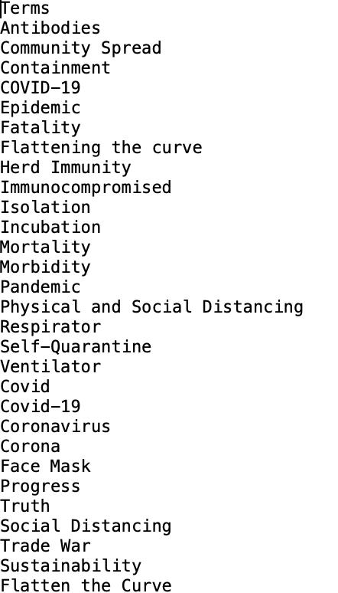
Overcoming Roadblocks
In order to combat the web scraper giving us stop words we set up parameters that made it easier to get the output that we needed.
To get words that related to covid, we researched various news outlets for most frequently used words during the pandemic.

Slide 12
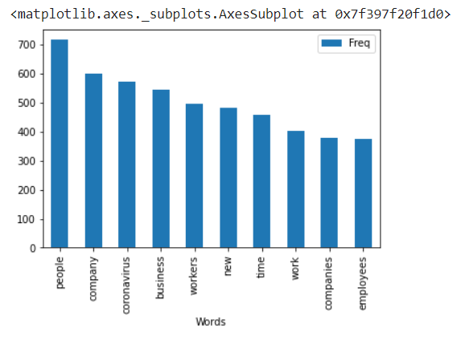
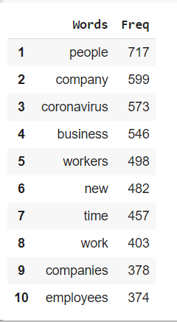
Words that showed up most frequently amongst all the articles

Slide 13
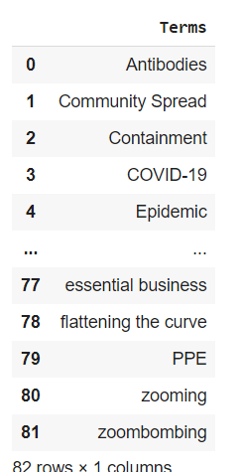
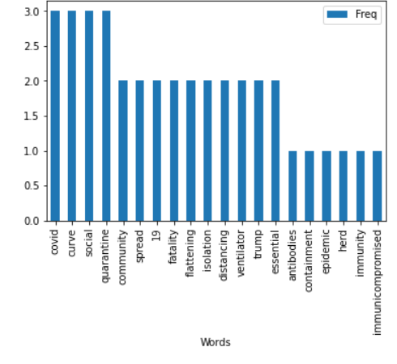
Our Application
Bar graph to show the frequency of how much these words showed up in the CNN business articles
Words in the pandemic.txt file

Slide 14

Lessons Learned
Learned about the severity of the pandemic
Explored more about the possibilities of machine learning through this project process and intense research.
Learned that the first way to do something is not always the best way
Learned that working on things simultaneously is the best way to get work done in a timely manner

Slide 15

Positive Impact
Signifies relevance of topics to users
Highlights the importance of a particular subject
Indicates popularity of certain words or topics

Slide 16

Negative Impact
Information may prompt people to make rash decisions
The nature of this application does not leave room for context
Risk of potential biases

Slide 17

Future Research
Where do we go from here?
How much chatter is there in the current day?
How will keywords be used moving forward?

Slide 18

References

Slide 19
Questions?

